Slide 1
MISSION IV: A Spy was able to acquire 5 pictures of important Byzantine technology. Use these photos to get an inside look at Byzantince life.

Slide 2
PICTURE # 1

Slide 3
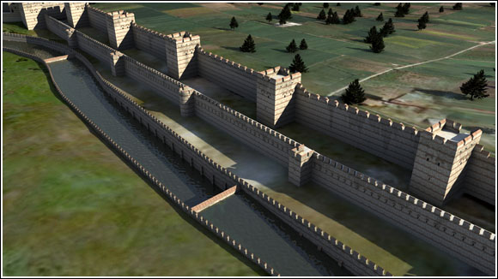
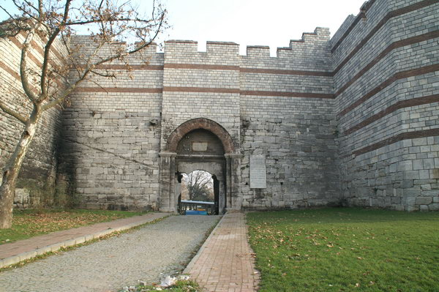
PICTURES FOR #2

Slide 4
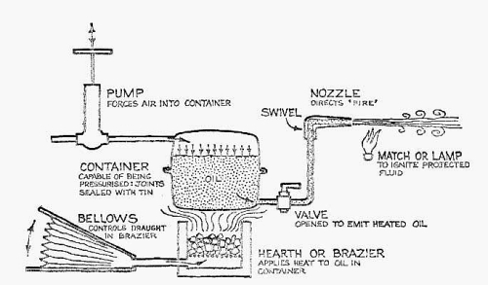
PICTURES FOR #3

Slide 5
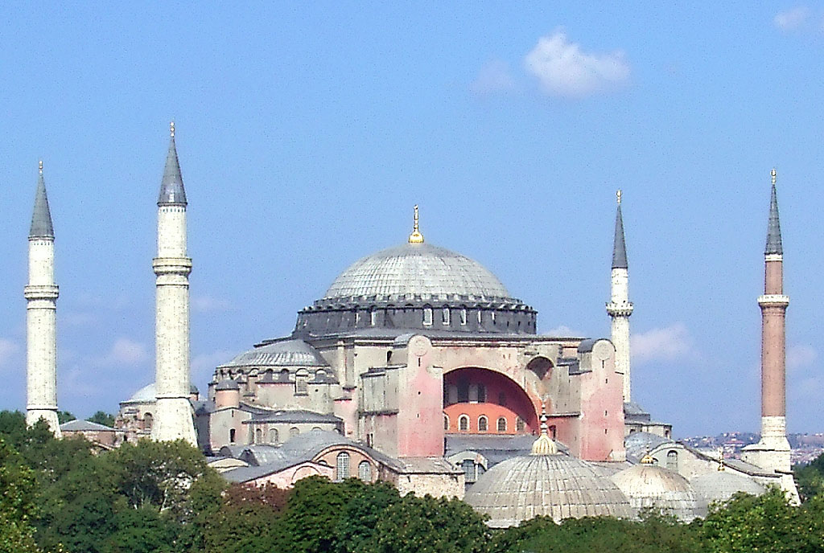
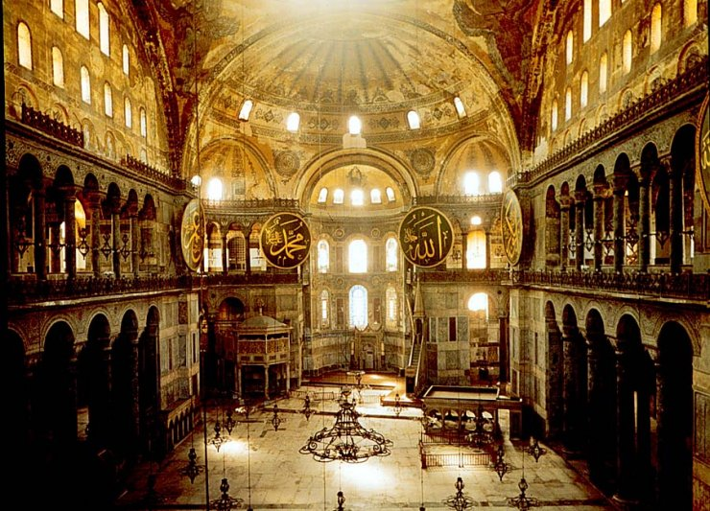
PICTURES FOR #4

Slide 6
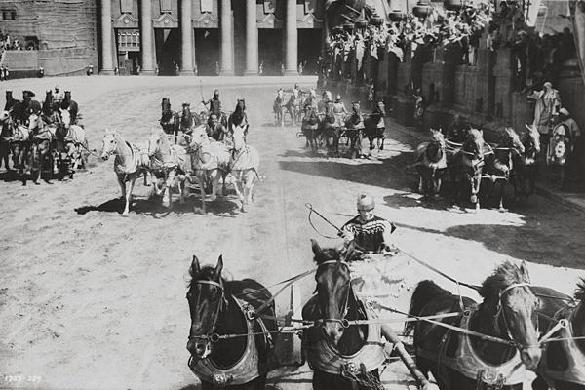
PICTURES FOR #5

